Slide 1
Center for Violence Prevention & Community Safety
established
July 1, 2005

Slide 2
Establishment of the Center
Vincent Webb conducted a self study of ASU research capacity
Marketed as an area for strategic private investment
Watts Family donated $3 million

Slide 3
What is the Center for Violence Prevention and Community Safety?
Center is affiliated with SCCJ:
Center’s Purpose
Ranked #5 in the nation
25 tenure track faculty
23 lecturers/instructors
Undergraduate
Masters
Ph.D.
Analyzing patterns & causes of violence
Evaluating policies and programs
Developing strategies and programs
Providing education, training & technical assistance
Facilitating the development & construction of databases
Notes:
3

Slide 4
Who Do We Work With?
International organizations & Foreign governments
United States Agency for International Development (USAID)
Organization of American States (OAS)
Inter-American Development Bank
Bill & Melinda Gates Foundation/ International Justice Mission
United Nations Development Program (UNDP)
Regional Security System (RSS)
Republic of Trinidad and Tobago
U.S. Federal Agencies
National Institute of Justice
Department of Homeland Security
Bureau of Justice Assistance
Local Agencies
Arizona Criminal Justice Commission
Governors Office
Maricopa County Managers Office
Maricopa County Attorneys Office
Law enforcement agencies
MCSO
Phoenix
Glendale
Mesa
Tempe
Tucson

Slide 5
Social Embedded-Use Inspired Research | Research and TA related to Racial Profiling
 | Increasing capacity to identify and respond to racial profiling and other constitutional violations.
Focused Deterrence | Crime Gun Intelligence Center
Collaboration that targets chronic violent offenders by directly interacting with offenders and communicating clear incentives for compliance and severe consequences for criminal activity. | Collaboration that focuses on the collection, management, and analysis of crime gun data and seeks to reduce gun-related crime in Phoenix

Slide 6
 | AZ-VDRS Defined
 | The Arizona Violent Death Reporting System combines official, confidential information on homicides and suicides in Arizona, developing an aggregated database from disparate, individual-level cases.
The AZ-VDRS Approach | AZ-VDRS Current Activities
Gather un-redacted reports on all suicides and homicides in Arizona on a monthly basis. Death certificates Autopsy and toxicology reports Police reports | Began data collection as of January 1, 2015. More than 50 participating LE agencies, covering more than 90% of all Arizona violent deaths. Approx. 1,700 violent deaths in Arizona On-going recruitment of law enforcement agencies across the state.

Slide 7
Assessing the Impact and Consequences of Police Officer Body-Worn Cameras | Project Research Questions
 | How do police officers perceive BWCs? Do those perceptions change over time? What are citizens’ perceptions of BWCs? Can BWCs be used as a mechanism for identifying best practices in violence reduction? Do BWCs lead to reductions in officer use of force and citizen complaints? Can BWCs facilitate sentinel event review? Do BWCs lead to changes in prosecutor charging practices, and case outcomes?
Sponsors | Research Activities
 | Survey officers about BWCs (over time) Survey citizens who have their police interactions recorded Compare use of force and citizen complaints over time Interview key internal and external stakeholders

Slide 8
Training and Technical Assistance for the US DOJ Body-Worn Camera Pilot Implementation (PIP) Program | Project Goals
 | Provide TTA to agencies as needed Provide guidance on BWC administrative policy Support successful implementation of BWCs Disseminate information related to BWC policy, practice, and outcomes
TTA Opportunities | Activities To-Date
Provide Information Webinars and podcasts Direct on-site assistance from subject matter experts (SME) Regional or topical workshops Long-distance support (web-based, phone, email) Speakers Bureau Peer-to-peer assistance National meetings | Review of BWC proposals (n=73) Assessment of TTA need Orientation webinar Initial TTA calls with agencies Development of BWC Policy Review Scorecard Administrative policy reviews National meeting planning Speakers Bureau presentations

Slide 9
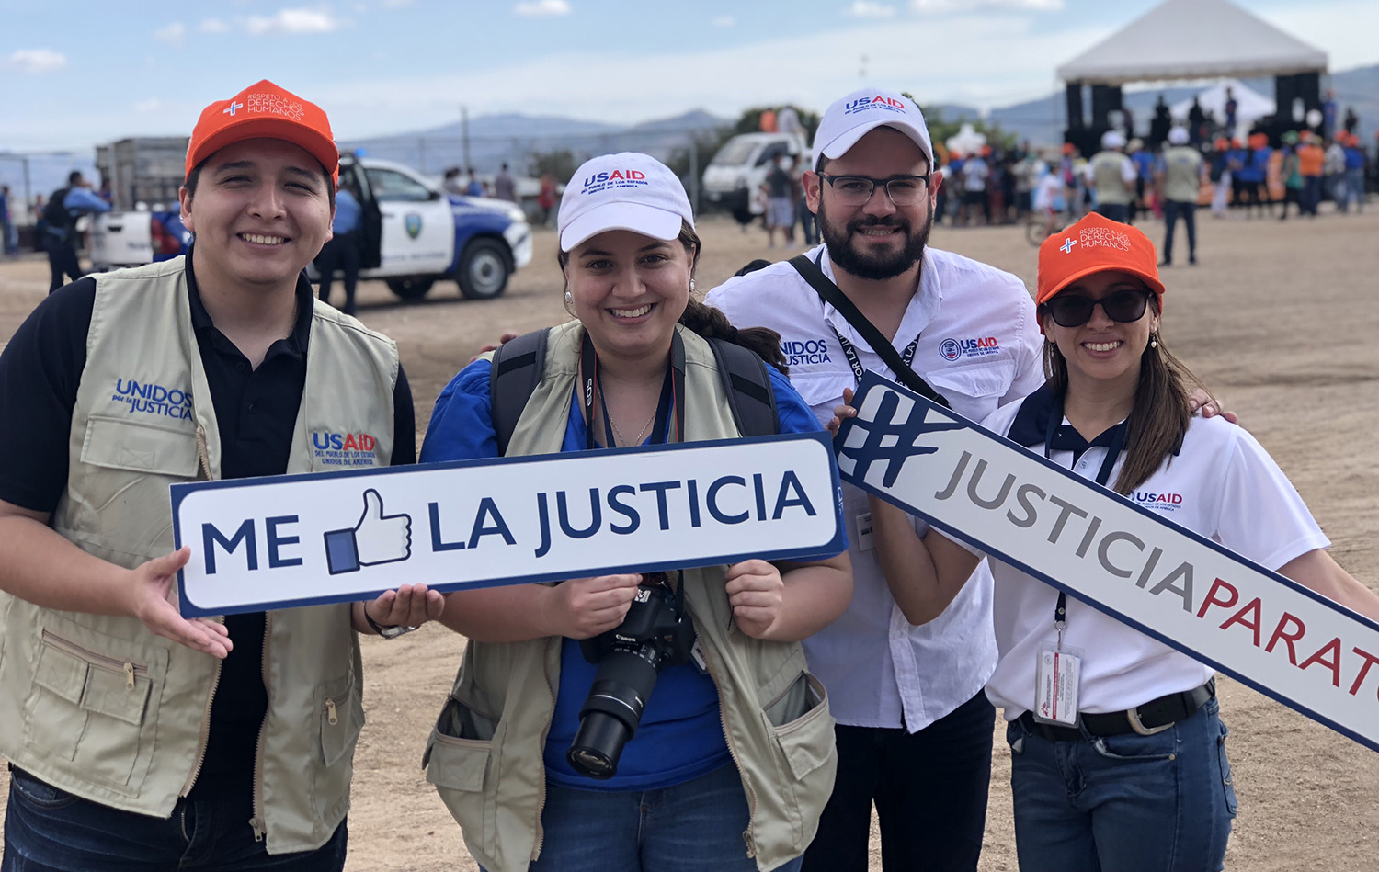
Central America | MS13 & Transnational Gangs
 | Understanding the scope, nature, organizational structure, and behavior of MS13 in El Salvador, Washington DC and LA.
Unidos por la Justicia (United for Justice) | Proponte Más Secondary Violence Prevention Activity
Documenting best practices in community policing in Honduras and holding a series of regional forums designed to promote those practices and design strategies for their replication. | Evaluating Proponte Más, which is an evidence-informed secondary prevention program that reduces youth risk factors through family based intervention programming.

Slide 10
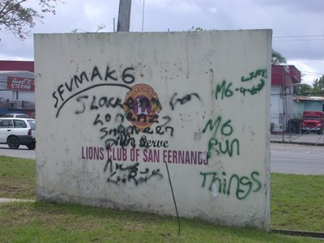
Caribbean | CariSECURE
 | CariSECURE draws on a public health approach to crime prevention. In adopting this approah, the Project will first work with technical personnel in public institutions to standardize and disaggregate citizen security data across the region.
Community, Family and Youth Resilience | Project REASON
ASU serves as CFYR’s external evaluation liaison and provides technical assistance on matters related to the adaption of the YSET and FACES to specialists in the three program nations and provide technical guidance on best practices on tertiary prevention interventions to the CFYR program. | Evaluation of Project Reason in Trinidad. It employs a public health approach, and works to interrupt the cycle of violence and to change norms about behavior. This is achieved through its five core components: street outreach to at risk youth, public education, faith leader involvement, community mobilization and collaboration with law enforcement.

