Slide 1
UNIDOS POR LA JUSTICIA
Strengthening Justice, Human Rights and Security in Honduras
Ana Karina Suazo

Slide 2
Background
The Justice, Human Rights and Security Program provides a holistic approach to USAID´s Place Based Strategy
Focused on 5 geographical areas in Honduras: Tegucigalpa, San Pedro Sula, La Ceiba, Choloma and Tela
Program has a duration of 5 years (2017-2021)

Slide 3
Program Objective
Improve citizen security and the conditions to reduce violence in target areas

Slide 4
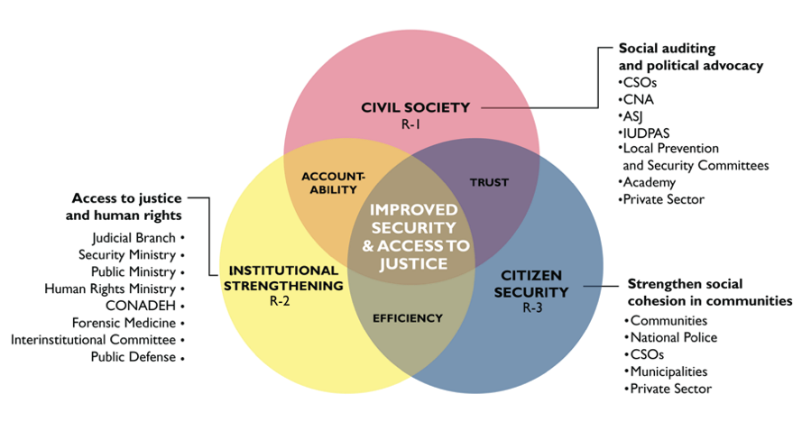
VINN DIAGRAM OF UNIDOS POR LA JUSTICIA PROGRAM
Notes:
“if citizen engagement with the security and justice sector improves (Sub-IR 2.1), and
if national and local justice and security institutions improve their capacity to prevent
and punish criminal activity through evidence-based, effective, integrated, and community-friendly methodologies (Sub-IR 2.2),
and if there is an increase in community police presence (Sub-IR 2.3), then [crime will go down and] citizen security will increase.”
Mention who the vulnerable groups are right from the start.
Women survivors of Gender Violence
LGTBI
Mental and physical disabilities
Ethnic groups specialy afro honduran population
Youth
Holistic approach
Vulnerable groups are victims of endemic levels of violence in Honduras. The acts of violence and injustice are increased when victims seek legal action because police and justice officials often blame and re-victimize women and other vulnerable populations.
More often than not, the first encounter that vulnerable groups have with justice operators are with national police. National police has adopted the community police model to engage with the community and start building trust. Police officers become active members of the community. When a relationship based on trust is achived they start receiving information so that police can develop more assertive policing activities.
In order to effectively reduce crime and increase citizen security, the relationship between civil society and justice operators needs to be supported by efficient security institutions that allow to prevent and punish criminal activity.How are we making justice organizations more accessible to vulnerable groups?
We are partnering with ASU to build the capacity of the educational police system to do research and analysis to develop assertive police strategies.
We partner with Chielean supreme court to assist the Honduran supreme court.

Slide 5
NATIONAL POLICE BUILDING TRUST WITH CIVIL SOCIETY ORGANIZATIONS AT OPPORTUNITIES FAIR FOR SOCIAL INCLUSION.
Notes:
The opportunities fair is an example of how Unidos provides the space where civil society organizations that represent different vulnerable groups such as LGTBI and people with physical disabilities and community police can interact. This allows vulnerable groups to interact in a safe space with justice operators, it also provides the opportunity for people whose rights have been breeched to teach police officers on how properly engage and support vulnerable groups.

Slide 6
CURRENT PRESIDENT OF THE ASSOCIATION FOR THE HEARING IMPARED
AND HER SIGN LANGUAGE INTERPRETER.
Notes:
UNIDOS has negotiated with the public ministry to pilot a project in La Ceiba to incorporate translators for local ethnic groups that do not speak Spanish and for the hearing impaired.

Slide 7
LEADER, ZULMA VALENCIA, ADVOCATES FOR ETHNIC RIGHTS IN LA CEIBA,
A TOWN IN THE NORTH COAST OF HONDURAS WITH A LARGE
COMMUNITY OF AFROHONDURANS.

Slide 8
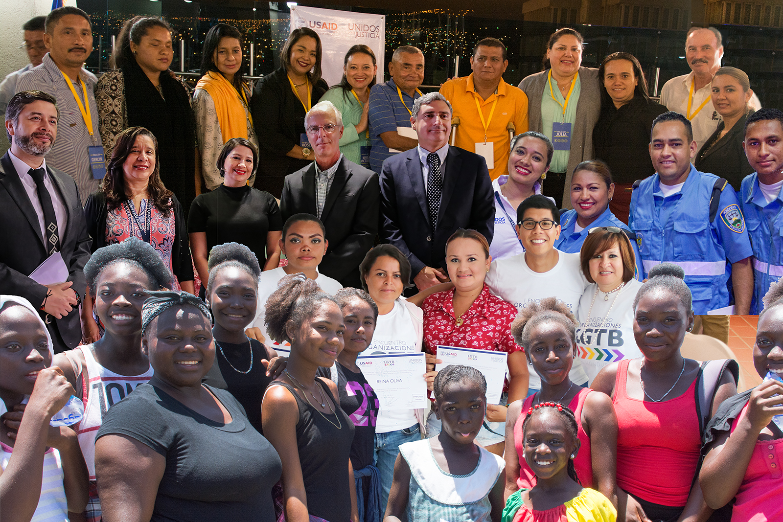
CLOSING REMARKS
Notes:
Unidos is also work with the public defendors, prosecutors, judges and national police.
Support forensic medicine to forensic evidence to prosecutors.
Fortalecer los CEIN, Integrated centers one stop shops.
By raising access to justice for vulnerable groups then Hondurans in general will have more access to justice.

