Slide 1
Theoretical and Scientific Foundations of Strategic Crime Control

Slide 2
Overview: Three Topics
What is scientific theory?
What is social science?
Strategic crime control

Slide 3
What is Scientific Theory?

Slide 4
Definition of a “Theory”
“a plausible or scientifically acceptable general principle or body of principles offered to explain phenomena…”
Source: www.merriam-webster.com/dictionary
Example: According to social disorganization theory,

Slide 5
What Makes a Theory “Scientific”?
Two primary ingredients
Provides an explanation for some phenomenon observed pattern or set of facts
It is testable and falsifiable

Slide 6
1st Ingredient: Explanation
In scientific theory, explanations involve the use of causal logic
A
B
“A causes B”
Notes:
Example: Social disorganization causes crime. Having delinquency friends causes individuals to themselves engage in delinquency.

Slide 7
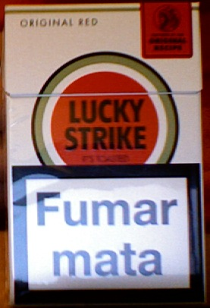
Example of a Causal Statement
A Lucky Strike cigarette pack from Portugal that contains a clear causal statement:
“Smoking kills”

Slide 8
Theories of Crime Causation
According to deterrence theory, individuals commit crime when the rewards of doing so are greater than the costs
According to social disorganization theory, socially disorganized communities have lower levels of informal social control, which leads to crime
According to broken windows theory minor forms of disorder, if left untended, generate more serious crime

Slide 9
2nd Ingredient: Testable & Falsifiable
A scientific theory can be tested using the scientific method.
The scientific method involves a set of steps designed to test the validity of a theory
Generate and test a hypothesis (a prediction) that is derived from a theory
If the theory is not valid, the scientific method can be used to falsify or invalidate it.
Notes:
Example: to test social disorganization theory, one might generate and test the hypothesis that communities with higher levels of poverty ( an indicator of social disorganization) will have higher rates of violent crime than communities with lower levels of poverty. If the theory is valid, there will be a positive relationship between poverty and the violent crime rate. If the theory is not valid, there will either be no relationship between poverty and crime or higher levels of poverty will be associated with lower levels of violent crime.

Slide 10
Example: Testing and Falsifying a Theory of Criminality
Italian criminologist Cesare Lombroso developed a theory of criminal anthropology in the late 19th century
His theory postulated that criminality is inherited, and that born criminals can be identified through certain physical characteristics

Slide 11
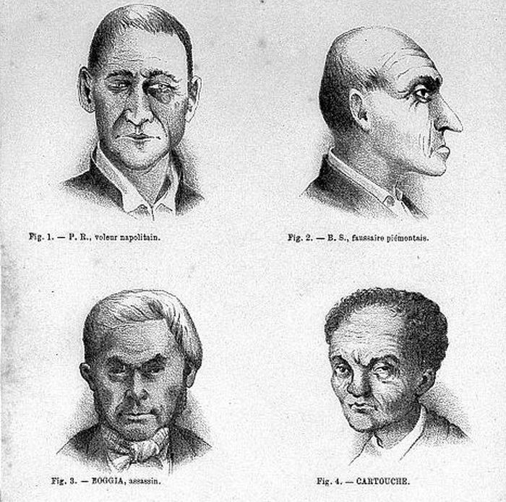
Lombroso’s Theory
Criminals represent a primitive form of man and can be distinguished from noncriminals by certain physical features
A sloping forehead, unusually shaped ears, an asymmetric face, bumps on the skull

Slide 12
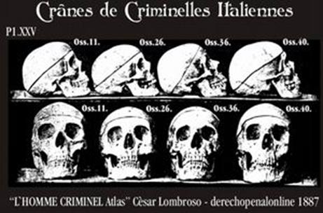
Lombroso Tested his Theory by Analyzing Skulls of Criminals
“Skulls of Italian Criminals”

Slide 13
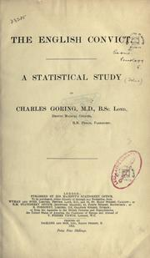
Falsifying Lombroso’s Theory
In his 1913 book, The English Convict: A Statistical Study, Charles Goring compared the physical characteristics of criminals and non-criminals and found no difference.
He concluded that “There is no such thing as an anthropological criminal type.”
First major study to falsify Lombroso’s theory.

Slide 14
Public Policies and Theory
Behind most policies are implicit theories. We can test those theories to see if they are valid.
For example, suppose a politician wants to enact a new policy to reduce crime by adopting lengthier prison sentences. Underlying this policy is an implicit theory that increasing the severity of punishment will reduce crime.
These implicit theories can be tested to help us determine whether we are adopting effective policies.

Slide 15
What Is Social Science?

Slide 16
Social Science
Social science is the application of the scientific method to the study of social life.
Social sciences include sociology, psychology, anthropology, political science, criminology, and others.
Each social science involves the development and testing of theory to understand the social world better.

Slide 17
Social Science Research Methods
Quantitative and qualitative methods
Prospective and retrospective approaches
Correlational and causal approaches
Cross-sectional and longitudinal approaches
Triangulation

Slide 18
Quantitative v. Qualitative Research
Quantitative methods rely on numerical data to understand social phenomena, like crime
The most common approach is statistical analysis of numerical data
But also social network analysis, spatial analysis, and simulation modeling
Qualitative methods rely on non-numerical data to understand social phenomena
The most common approach is analysis of textual data from interviews, observations, or from communications media (songs, books, movies, speeches, newspapers)

Slide 19
Prospective v. Retrospective Research
Prospective research involves studying a phenomenon before it occurs.
For instance, if we are interested in learning how children begin to exhibit delinquent behavior, we can select a birth cohort of infants and study them as they age.
Retrospective research involves studying a phenomenon once it has already occurred.
For instance, if we are interested in learning how a neighborhood became a crime hot spot, we can examine historical data about the neighborhood.

Slide 20
Correlational v. Causal Research
Correlational research can establish that two or more phenomena have a statistical relationship, but not that one phenomena causes the other
Establishing correlation is much easier than establishing causation.
Causal studies are designed to establish causation between two or more phenomena.
Problem: many studies that infer causation rely on research designs that do not support such inferences.
Notes:
There is a correlation (an association) between gang membership and involvement in juvenile delinquency (but not that being in a gang causes delinquency) versus smoking causes cancer.

Slide 21
Cross-Sectional v. Longitudinal Research
Cross-sectional research is based on a “snapshot” in time
Data are collected at one point in time, and can only describe the phenomena of interest at that one point in time.
Problem: very difficult to establish causation with cross-sectional data.
Longitudinal research is based on data gathered over time
Time is an explicit component of longitudinal designs, thus allowing for stronger inferences about change over time.
Longitudinal research is necessary to establish causation.
Notes:
Homicide rates in countries with and without the death penalty in 2018 versus homicide rates in countries with and without the death penalty from 1950 to 2010.

Slide 22
Triangulation
Using multiple research methods to study the same phenomenon
Relationship between gang membership and juvenile delinquency using
Quantitative self-report data on gang membership and participation in various types of delinquency at one point in time
Qualitative data from interviews with gang members

Slide 23
Why is Social Science Important?
Provides us with a rigorous toolbox of methods for testing our assumptions about crime and its causes.
Enables us to evaluate the effectiveness of the interventions we put in place to prevent or control crime.
Helps us accumulate a body of research evidence about how to reduce crime

Slide 24
Strategic Crime Control

Slide 25
What is Strategic Crime Control?
Represents the application of scientific theory, data analysis, and research evidence to the selection of strategies intended to prevent and control crime

Slide 26
Strategic Crime Control
Analysis of strategies implemented by individuals, communities, businesses, non-government organizations and all levels of government to target the various social and environmental factors that increase the risk of crime, disorder and victimization

Slide 27
Strategic Crime Control
Relies on empirical evidence from criminology and crime science about how best to prevent and reduce crime
Goal—identify “what works” in preventing or reducing crime and recidivism
Thus, evidence-based correctional programming, evidence-based policing, evidence-based crime prevention

